Slide 1

មេរៀនទី១0
ឃ្លាបញ្ជារង្វិលជុំ(Loop Statement)

Slide 2

រៀបចំដោយ ក្រុមទី០១
១.ម៉ោះ រ៉ៃមី ២.អេង សុភាព
៣.ពេជ្រ ស្រីខួច ៤.ឆ្លាវ គិមស៊ុន់
៥.ឡូ ស្រីពេជ្រ ៦.មាំង សុផា

Slide 3
១. ប្រភេទខុសគ្នានៃរង្វិលជុំ
រង្វិលជុំត្រូវបានប្រើដោយប្រតិបត្តិប្លុកលេខកូដដដែលម្ដងហើយម្ដងទៀត។ដរាបណាលក្ខខណ្ឌជាក់លាក់ត្រូវបានបំពេញគំនិតជាមូលដ្ឋាននៅពីក្រោយរង្វើជុំគឺស្វ័យប្រវត្តិភារកិច្ចច្រំដែលនៅក្នុងកម្មវិធីដើម្បីសន្សំពេលវេលានិងការខិតខំប្រឹងប្រែងកម្មវិធី PHP គាំទ្ររង្វិលជុំ 4 ប្រភេទផ្សេងៗគ្នា។

Slide 4
១. ប្រភេទខុសគ្នានៃរង្វិលជុំ
While -loops through a block of code as loge as the condition specified evaluate to true.
Do-while the block of code executed once and then condition is evaluate. If the condition is true the statement is repeated as loge as the specified condition is true.
For- loops through a block of code until the counter reaches a specified number .
Foreach- loops through a block of code for each element in an array.

Slide 5
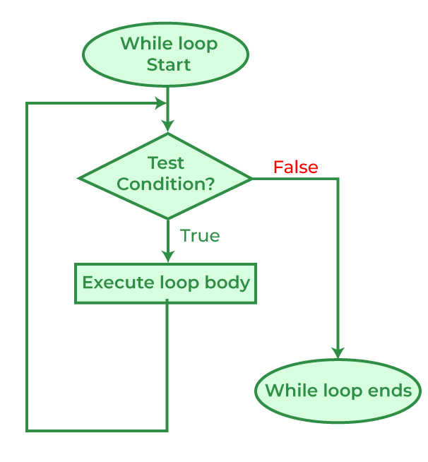
២.ឃ្លារង្វិលជុំ While -loops
និយមន័យ៖
The while statement will loops through a block of code as loge as the condition specified in the while statement evaluate to true.
while(condition){
// code to be executed.
}

Slide 6
ឧទាហរណ៍
<?php
echo "<br>";
$x = 0;
while($x < 10) {
if ($x == 4) {
$x++;
continue;
}
echo "The number is: $x <br>";
$x++;
}
?>
<?php
while($i<=3){
$i=1;
// code to be executed.
$i++;
echo "The nuber is ".$i."<br>";
}
?>

Slide 7
ឧទាហរណ៍
Use by break;
<?php
echo "<br>";
$x = 0;
while($x < 10) {
if ($x == 4) {
break;
}
echo "The number is: $x “<br>";
$x++;
}
?>

Slide 8
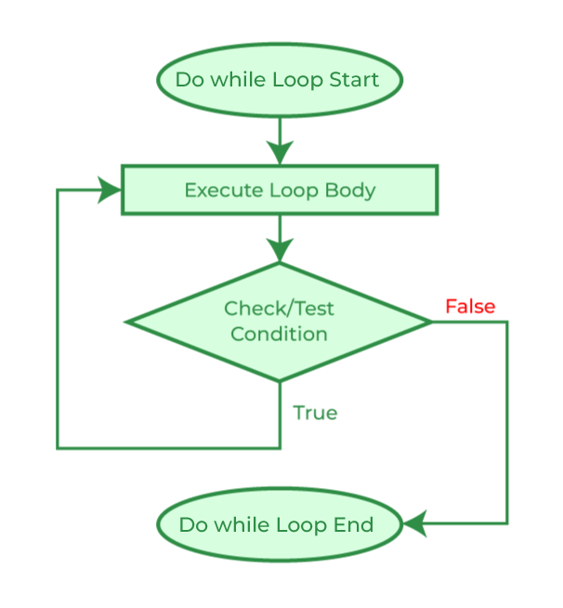
២.ឃ្លារង្វិលជុំ do...While -loops
និយមន័យ៖
The do-while loops is a variant of while loops ,which evaluates the condition at the end of each loops iteration .With a do-while loop the block of code execute once and then the condition is evaluated, if the condition is true, the statement is repeated as loge as the specified condition evaluated to is true.

Slide 9
២.ឃ្លារង្វិលជុំ do...While -loops
និយមន័យ៖
The do-while loops is a variant of while loops ,which evaluates the condition at the end of each loops iteration .With a do-while loop the block of code execute once and then the condition is evaluated, if the condition is true, the statement is repeated as loge as the specified condition evaluated to is true.
ទំរង់ទូទៅ៖
do{
code to be executed ;
} while(condition);

Slide 10
២.ឃ្លារង្វិលជុំ do...While -loops
ឧទាហរណ៍៖ បង្ហាញលទ្ធផល "Have a good day!" ប្រសិនបើcondition true វានិង loop "Have a good day!" ច្រំដែល​ រហូតទាល់តែ condition false ទើបចាកចេញ ។
<?php
$t = 1;
do{
$t++;
echo "Have a good day!";
} while($t<=3);
?>

Slide 11
៣.ភាពខុសគ្នារវាង while and do-while loop
The while loop differs from the do-while loop in one important way with while loop the condition to be evaluated is test at the beginning of each loop iteration ,if the conditional expression evaluated to false the loop will never be execute.
With the do-while loop on the other hand ,the loop will always be executed once, event if the conditional expression is false, cause the condition is evaluated at the end of loop iteration rather than the beginning.

Slide 12
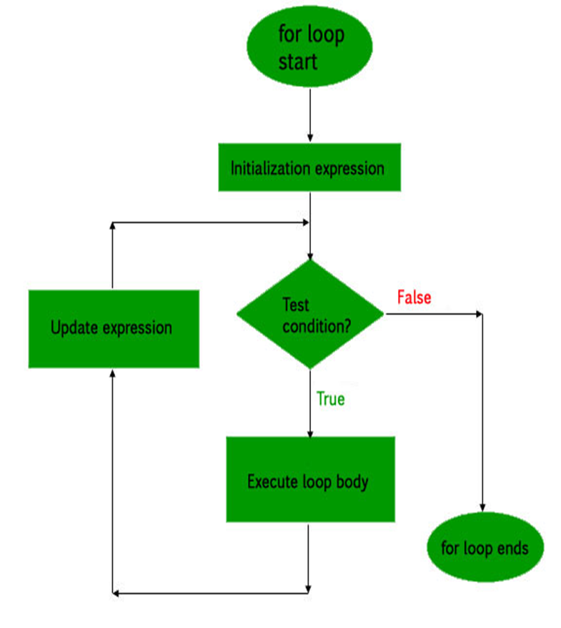
៤.ឃ្លារង្វិលជុំ for loop
និយមន័យ៖
The for loop repeats a block of code as loge as a certain condition is met. It is typically used to execute a block of code for certain number of time.
ទំរង់ទូទៅ៖
For(initialization; condition; increment){
// code to be executed.
}

Slide 13
៤.ឃ្លារង្វិលជុំ for loop
Initialization it is use to initialize the counter variables, and evaluated once unconditionally before the first Execute OF the body of the loop.
Condition in the beginning of each iteration is evaluated , if it evaluated to true the loop continue and nested statements are execute , if it valuated to false , the execution of the loop ends,
Increment it update the loop counter with a new value . It is evaluate at the end of each iteration.

Slide 14
៤.ឃ្លារង្វិលជុំ for loop
ឧទាហរណ៍៖ បង្ហាញនូវប្រយោគ "Have a good morning!" ។ ប្រសិនបើ​condition is true វានិងបង្ហាញ "Have a good day!"ច្រំដែលរហូត condition is false ទើបចាកចេញ។​
<?php
for ($t=1; $t<=3; $t++) {
echo "Have a good morning! <br>";
}
?>

Slide 15
៤.ឃ្លារង្វិលជុំ for loop
<?php
$even="";
$odd="";
for($i=1;$i<=50;$i++){
if($i%2==0){
$even = $even . " " .$i ;
}else{
$odd = $odd . " " .$i;
}
echo "The Even no = " . $even."<br/>";
echo "The Odd no = " . $odd;
}
?>

Slide 16
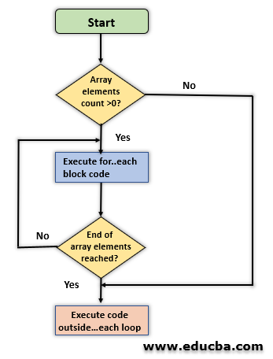
៥. ឃ្លារង្វិលជុំ Foreach loop
និយមន័យ៖ The foreach loop is used to iterate over arrays.
ទំរង់ទូទៅ៖
foreach ($array as $value) {
// code to be execute.
}

Slide 17
ឧទាហរណ៍
The following example demonstrates a loop that will print the value of the given array.
<?php
$colors = array("Red", "Blue", "Green");
foreach($colors as $value){
echo $value."<br>";
}
?>

Slide 18
ឧទាហរណ៍
The following example demonstrates a loop that will print the value of the given array. The following example demonstrates a loop that will print the value of the given array.
<?php
$colors = array("Red", "Blue", "Green");
foreach($colors as $value){
echo $value."<br>";
}
?>

Slide 19
ឧទាហរណ៍
The following example demonstrates a loop that will print the value of the given array. The following example demonstrates a loop that will print the value of the given array.
<?php
echo "<br>";
$arr = array(1,2,3,4,5);
foreach($arr as $value)
{
echo $value * 3;
echo "<br>";
}
?>

Slide 20
៥. ឃ្លារង្វិលជុំ Foreach loop
There is one more syntax of foreach loop , which is extension of the first.
foreach ($array as $key => $value) {
// code to be execute.
}

Slide 21
៥. ឃ្លារង្វិលជុំ Foreach loop
<?php
$sub = array(
"name" => "peter park",
"email" => "peterpark@gmail.com",
"age" => 32
);
foreach($sub as $key => $value)
echo $key . " :" .$value . "<br>";
?>

Slide 22

Any Questions?

Slide 23

អរគុណសម្រាប់ការចូលរួមស្ដាប់របស់អ្នកទាំងអស់គ្នា

